Slide 1

HR Analysis Data Challenge
Student final dashboards
Trainer: Anh Leimer Training Assistants: Hanna Nguyen, Trang Tran & Hien Tran

Slide 2
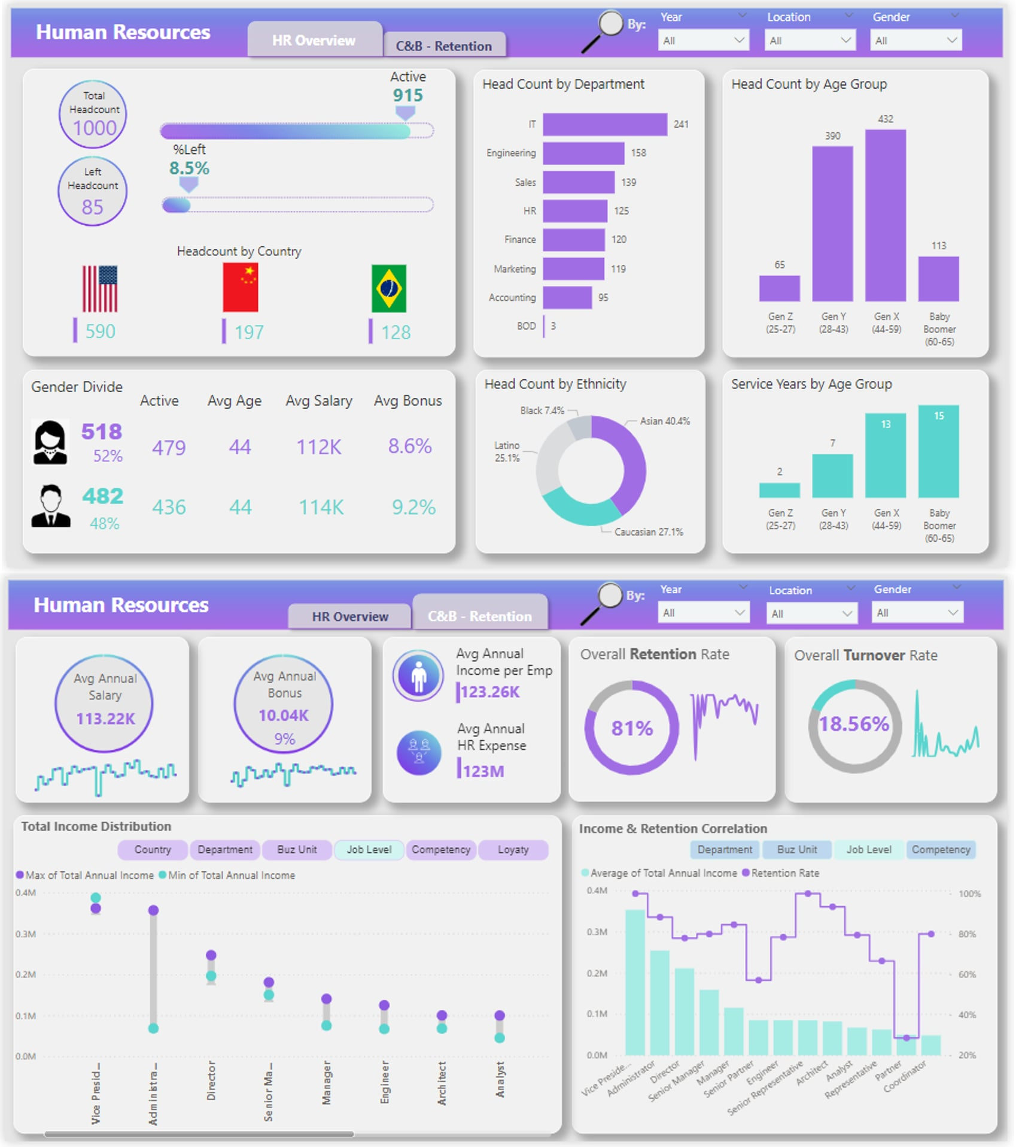
HR Analysis Dashboard – FP20 Data Challenge
Link to Linkedin post by Sunny Nhat Le

Slide 3
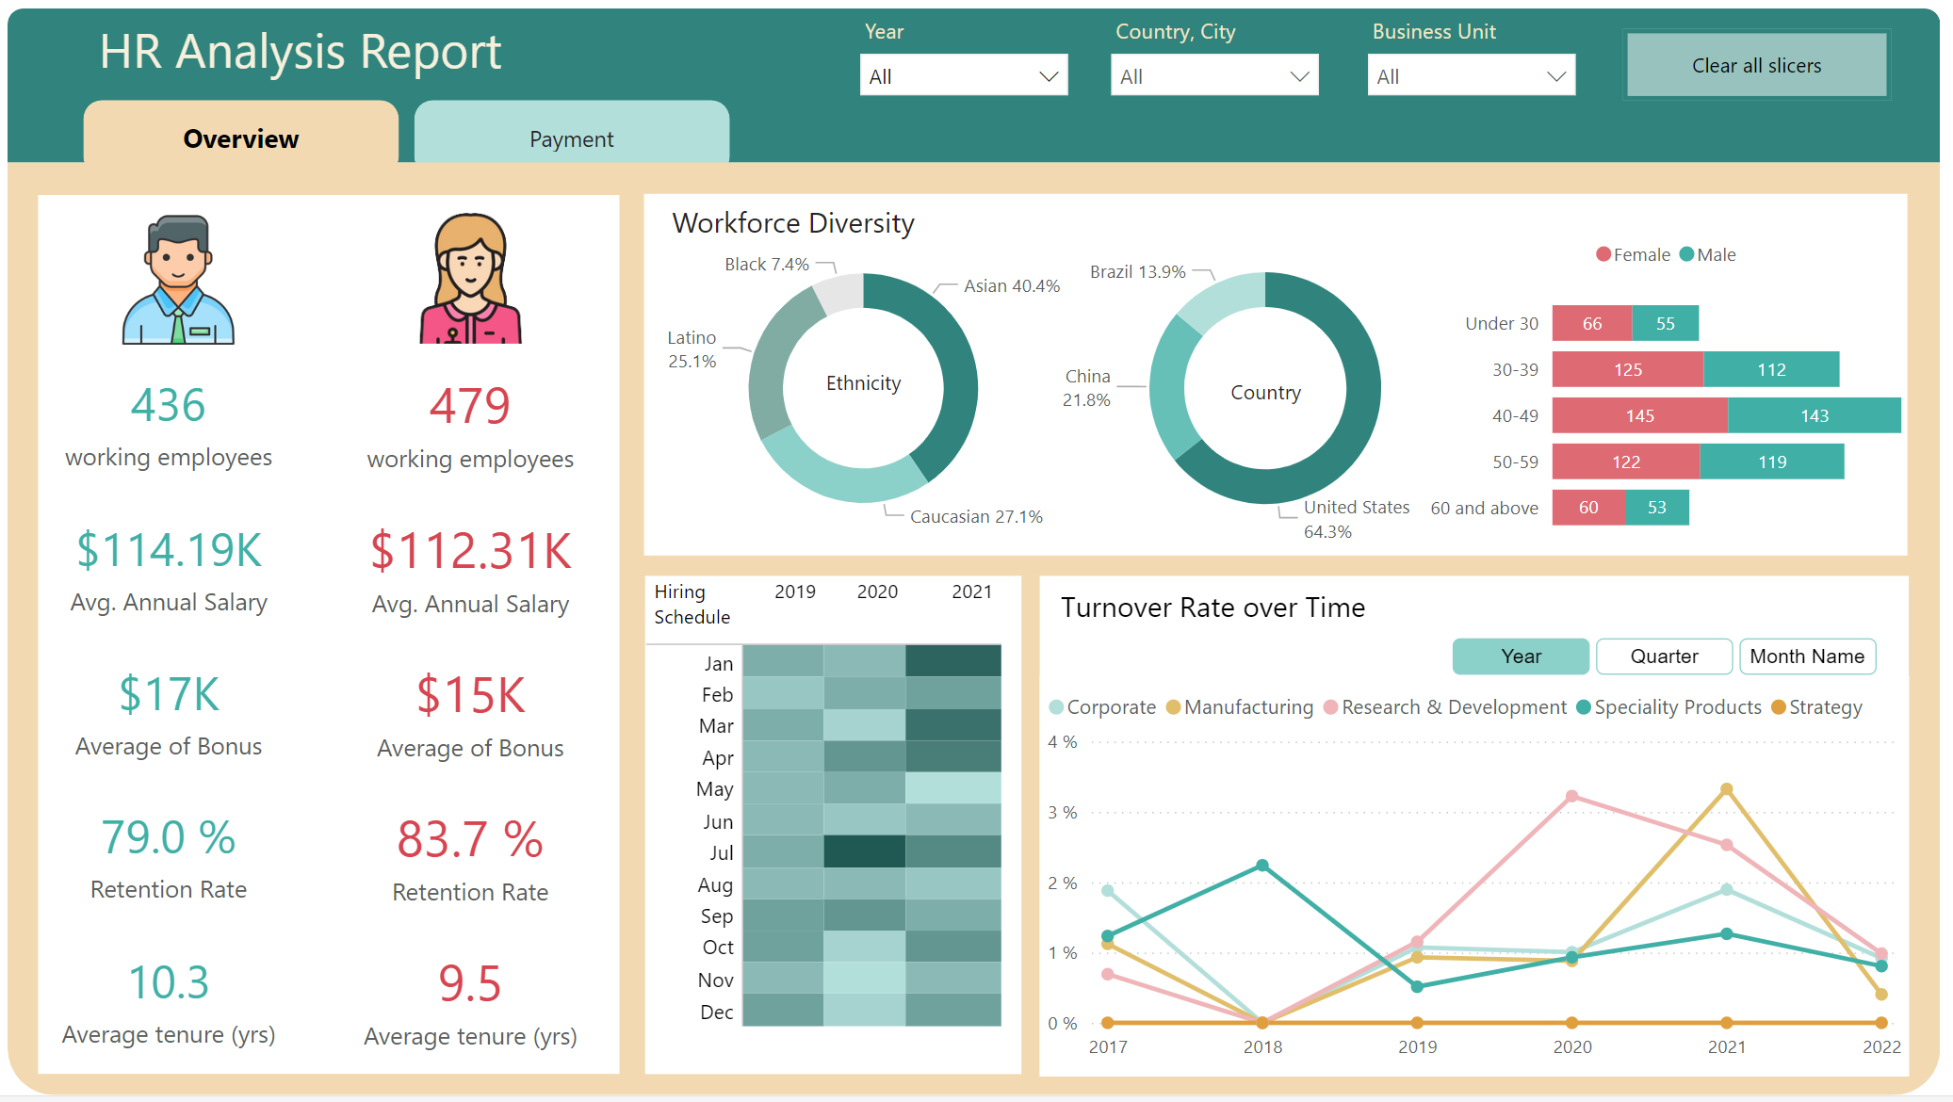
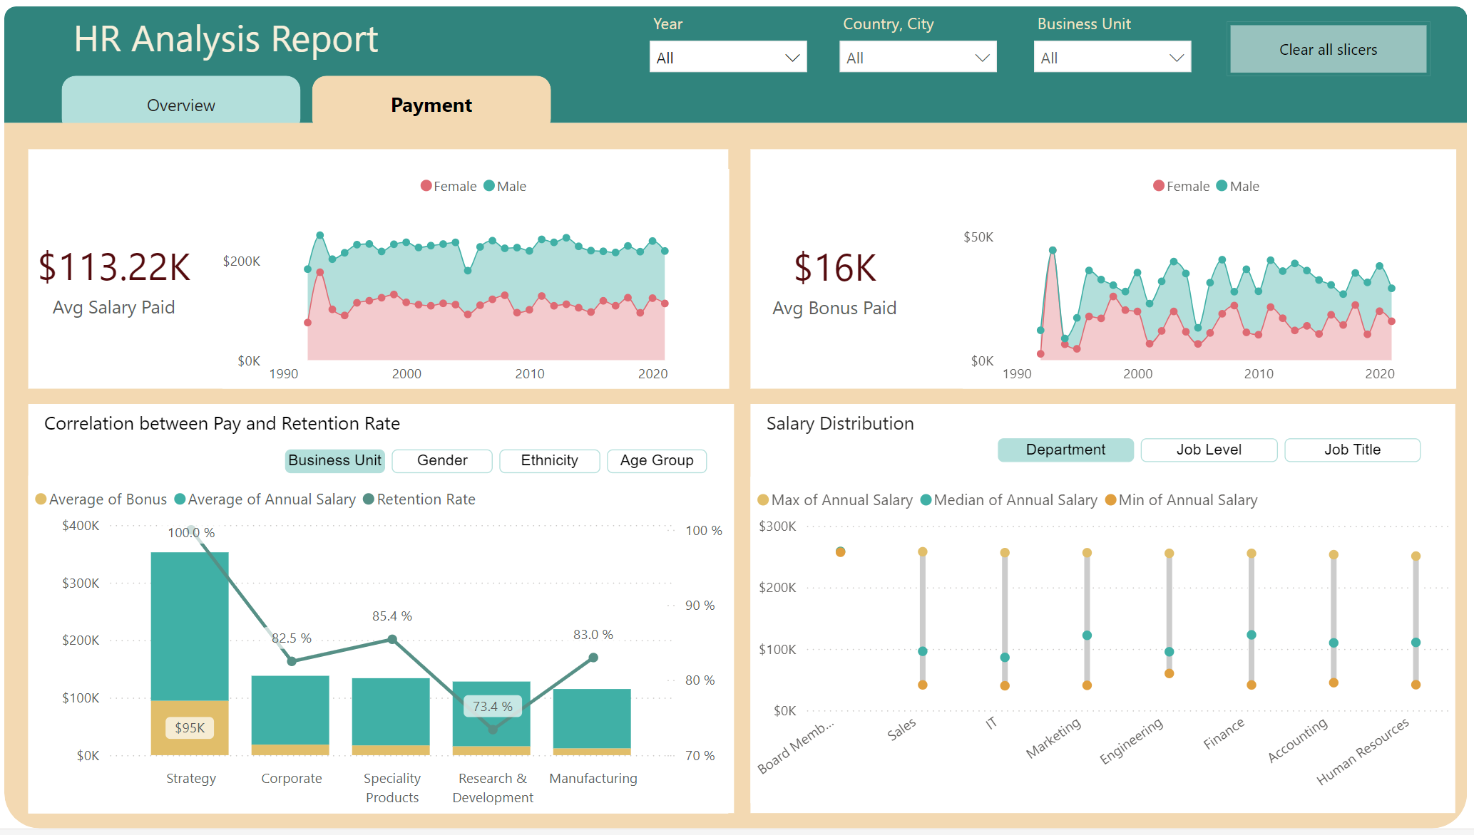
HR Analysis Dashboard – FP20 Data Challenge
Link to Linkedin post by Huyen Nguyen

Slide 4
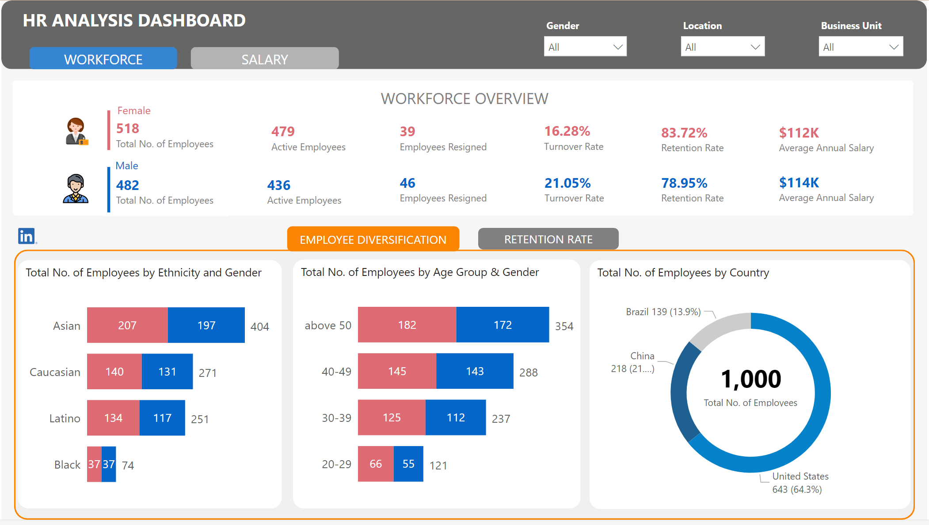
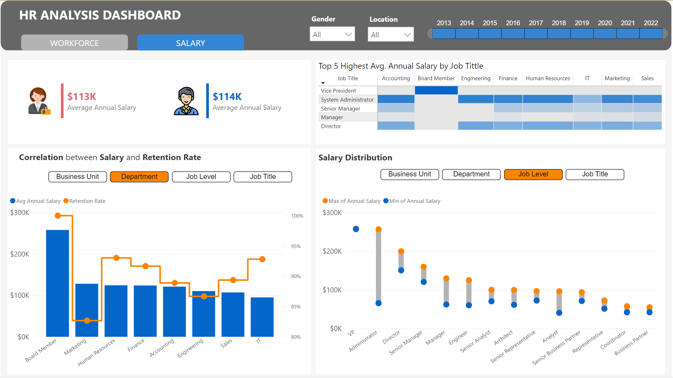
HR Analysis Dashboard – FP20 Data Challenge
Link to Linkedin post by Huu Quang Nguyen

Slide 5
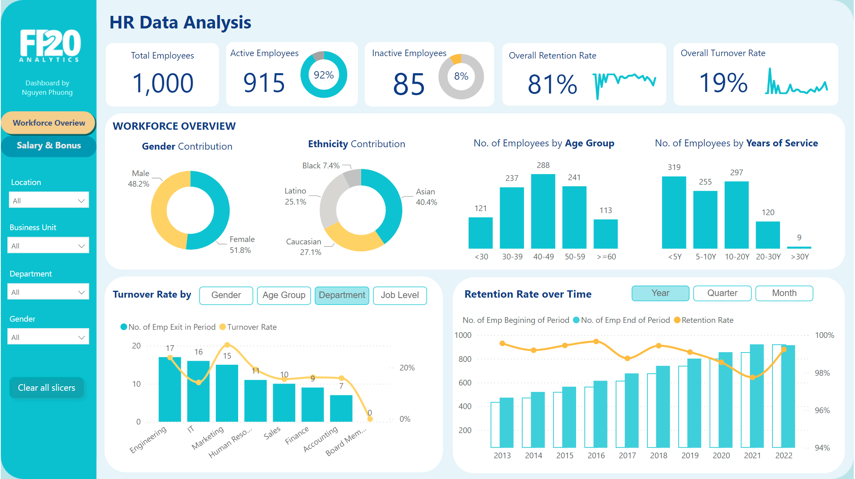
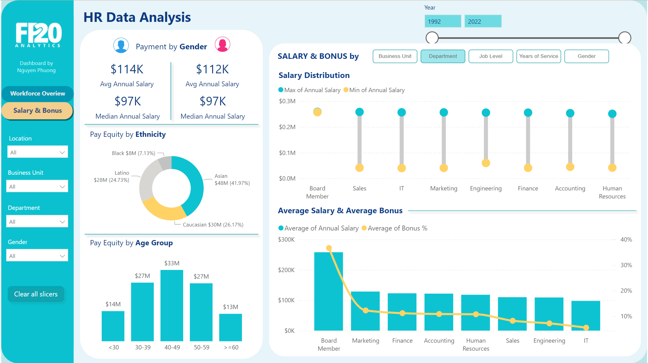
HR Analysis Dashboard – FP20 Data Challenge
Link to Linkedin post by Phuong Nguyen

Slide 6
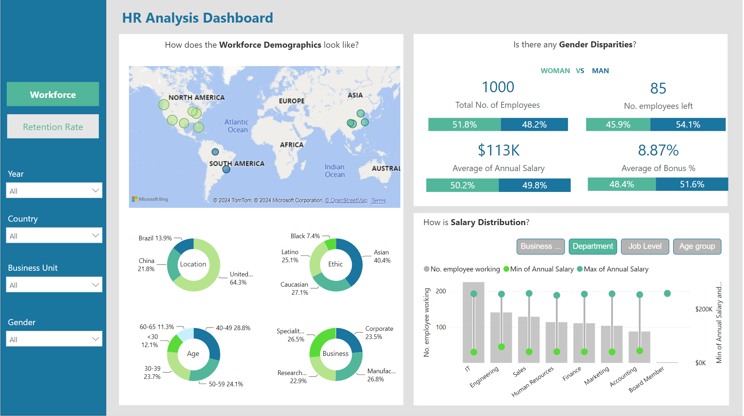
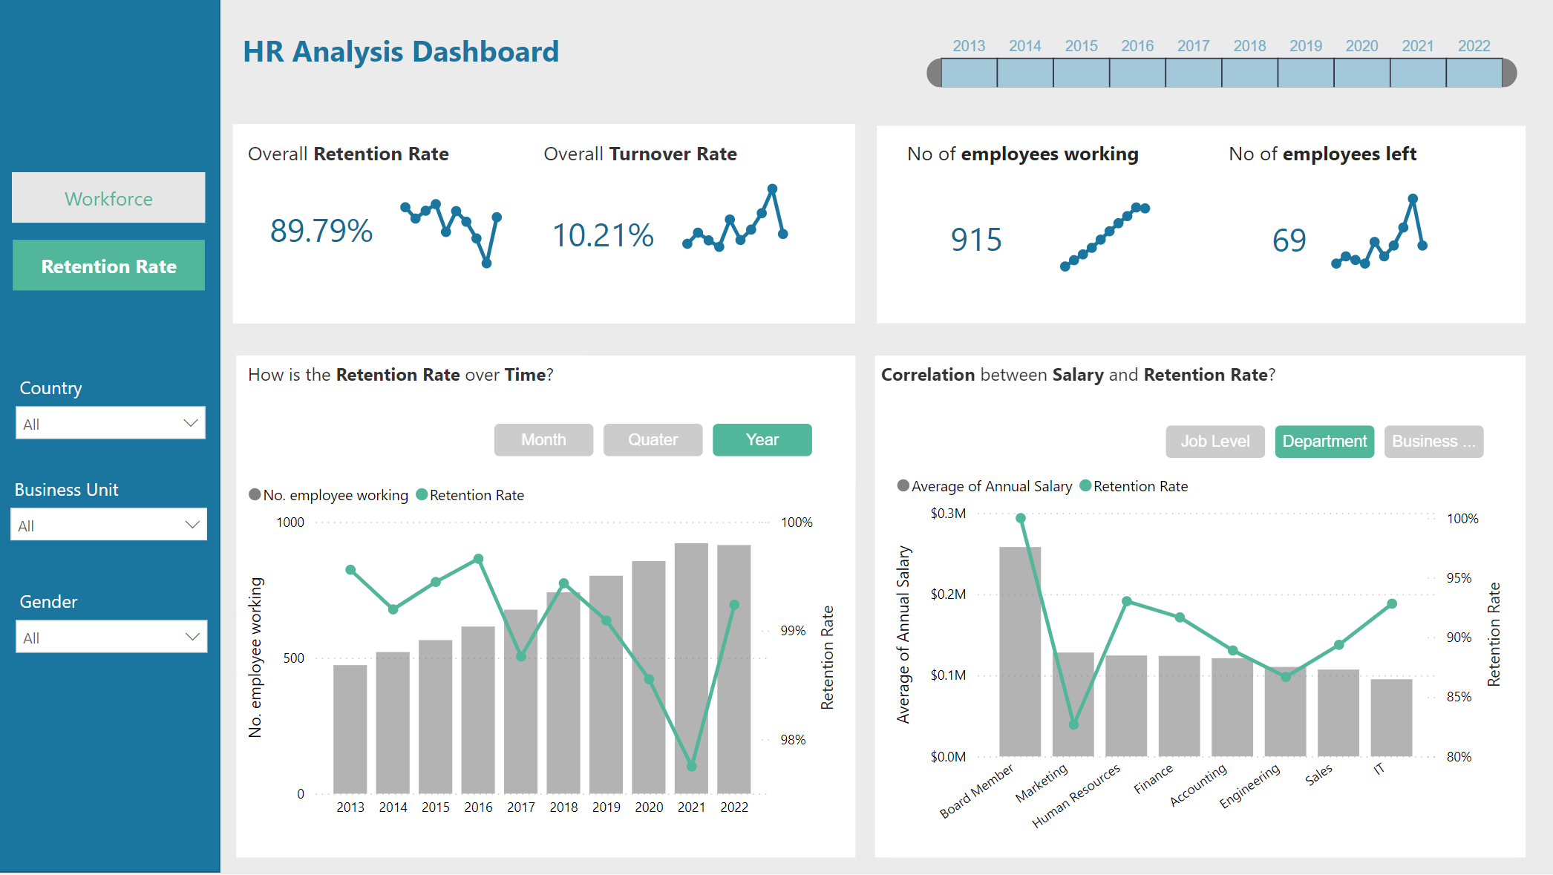
HR Analysis Dashboard – FP20 Data Challenge
Link to Linkedin post by Y Platek

Slide 7
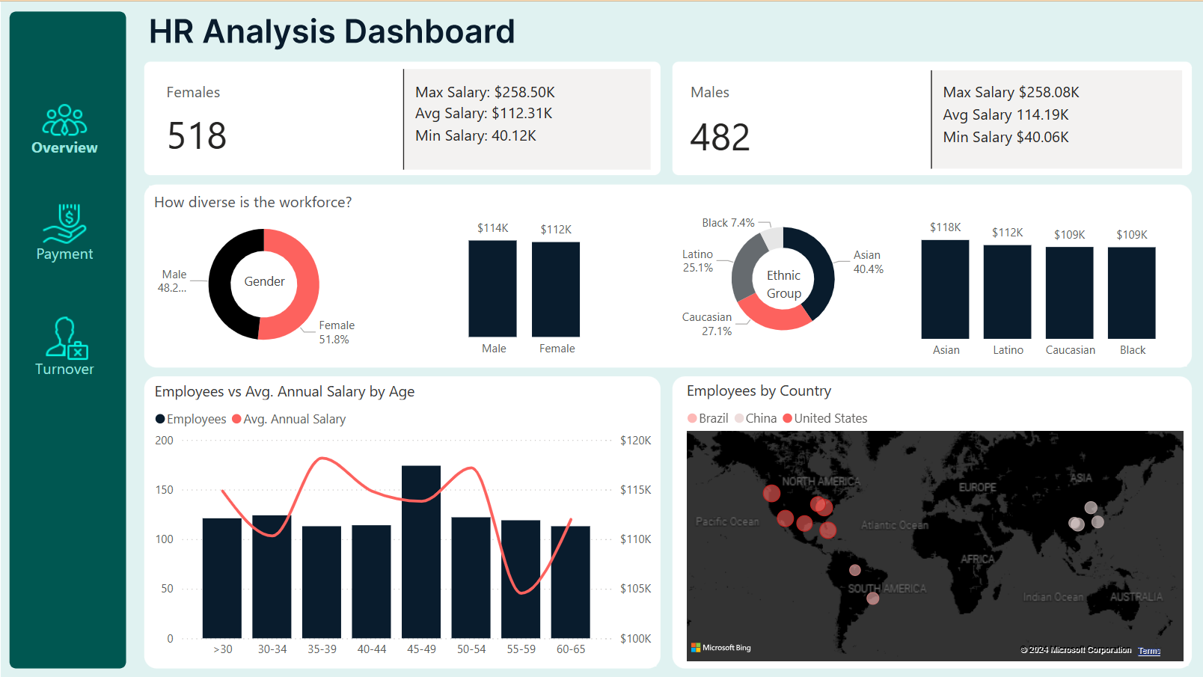
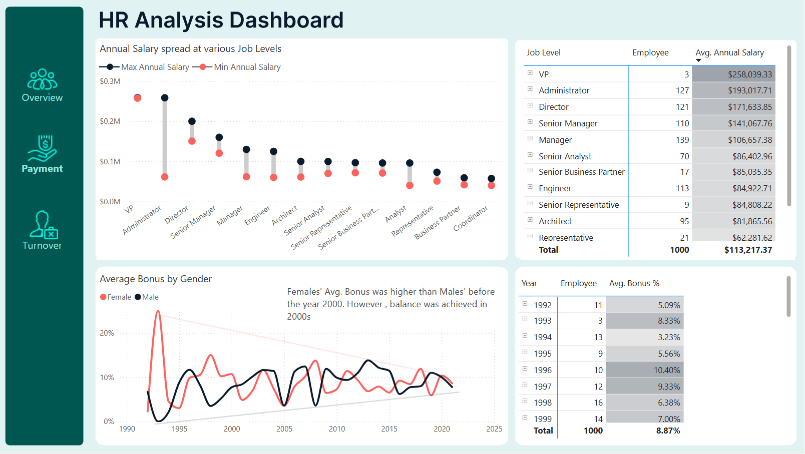
HR Analysis Dashboard – FP20 Data Challenge
Link to Linkedin post by Blessing Jegede

Slide 8
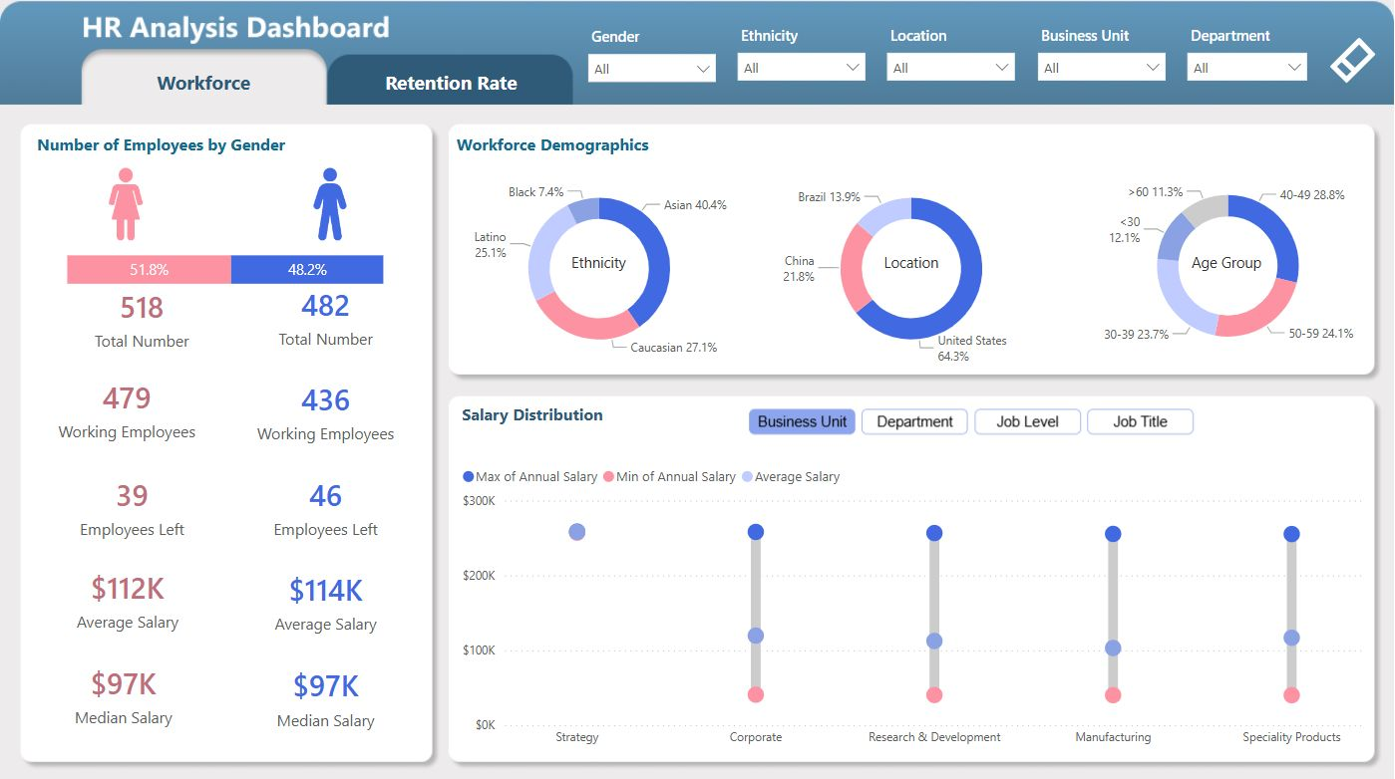
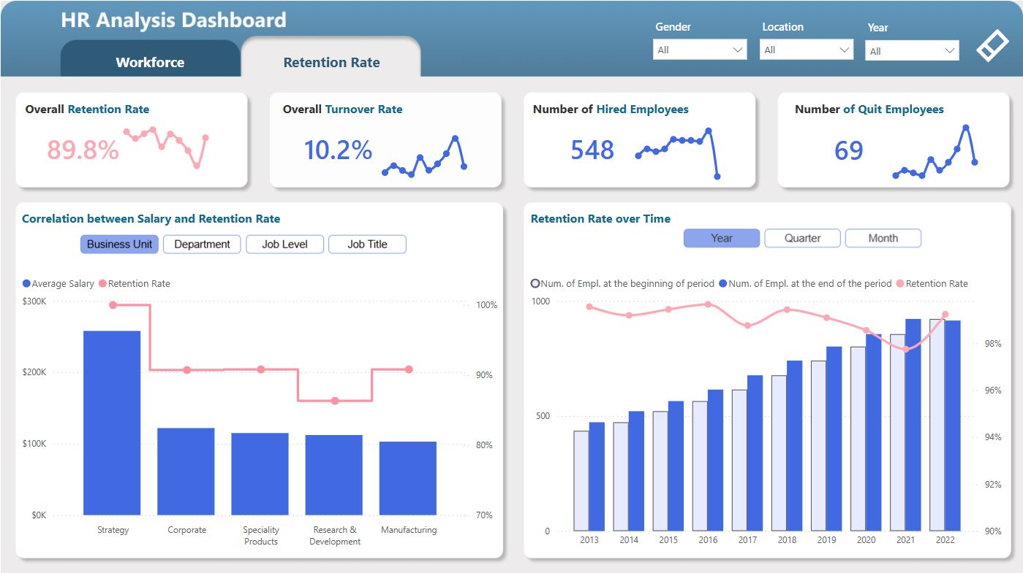
HR Analysis Dashboard – FP20 Data Challenge
Link to Linkedin post by Borys

Slide 9
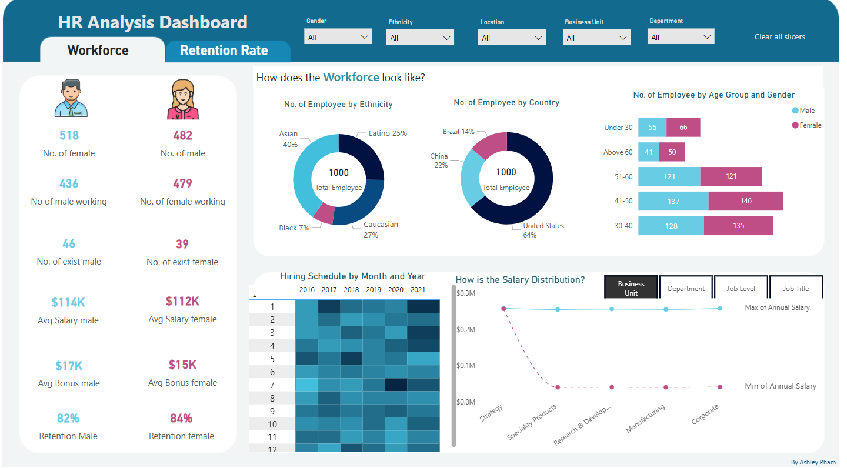
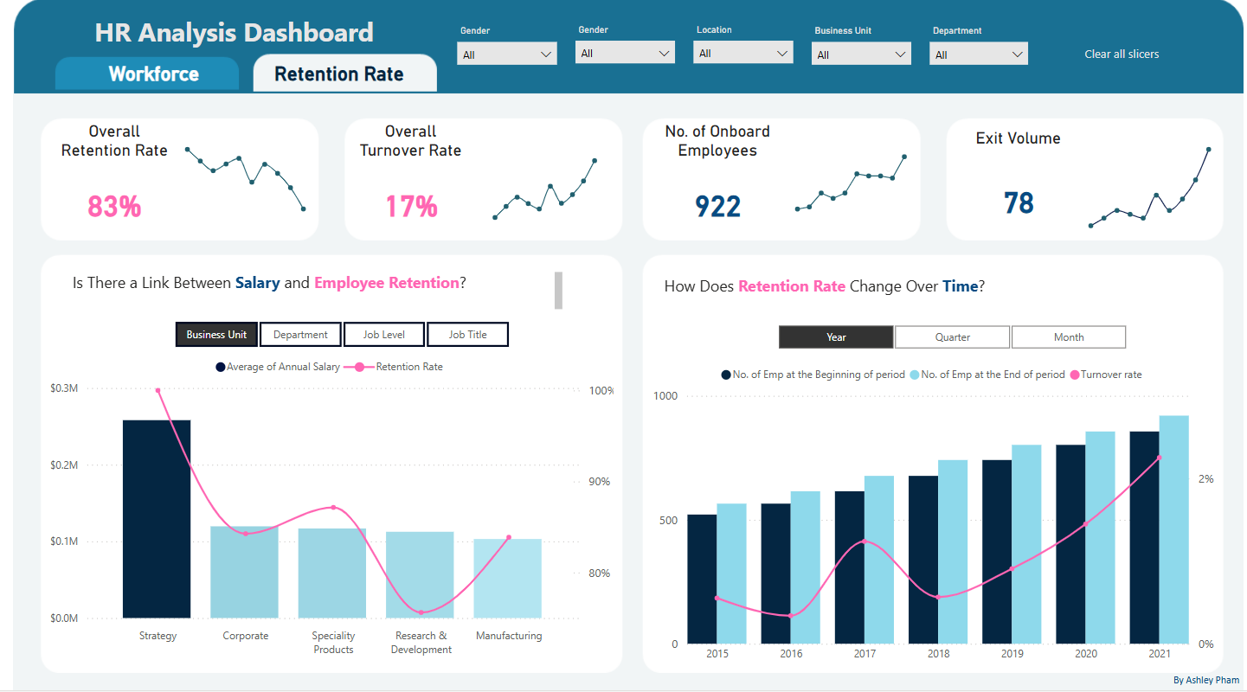
HR Analysis Dashboard – FP20 Data Challenge
Created by Ashley Pham

Slide 10
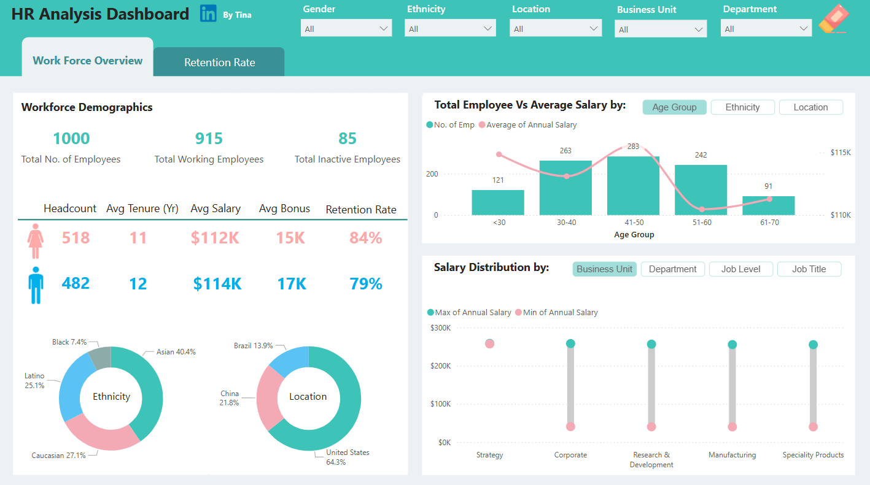
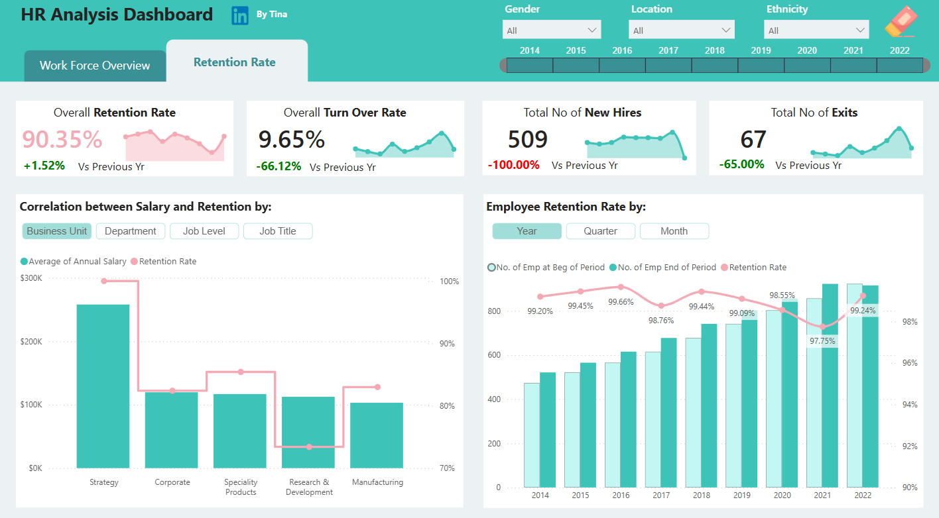
HR Analysis Dashboard – FP20 Data Challenge
Link to Linkedin post by Tina E

Slide 11
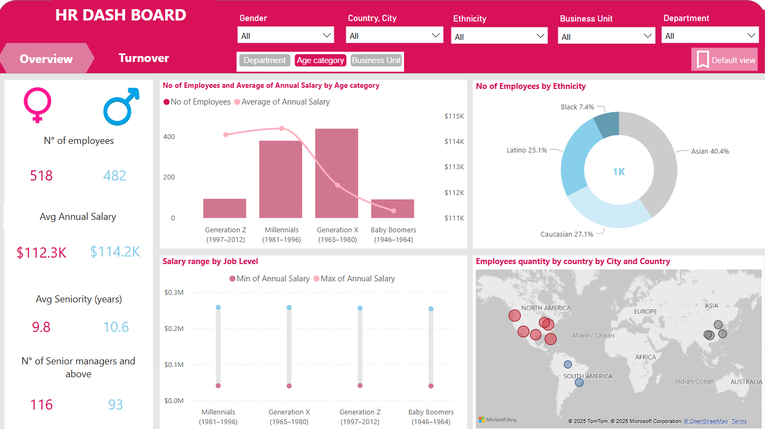
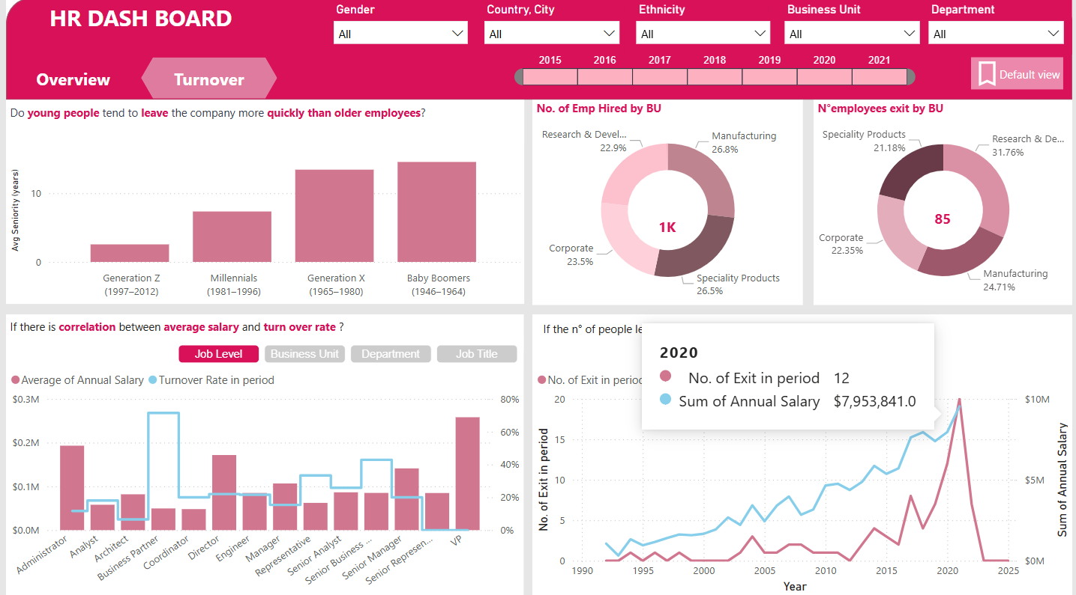
HR Analysis Dashboard – FP20 Data Challenge
Created by Phuc Bao Vy Nguyen

Slide 12
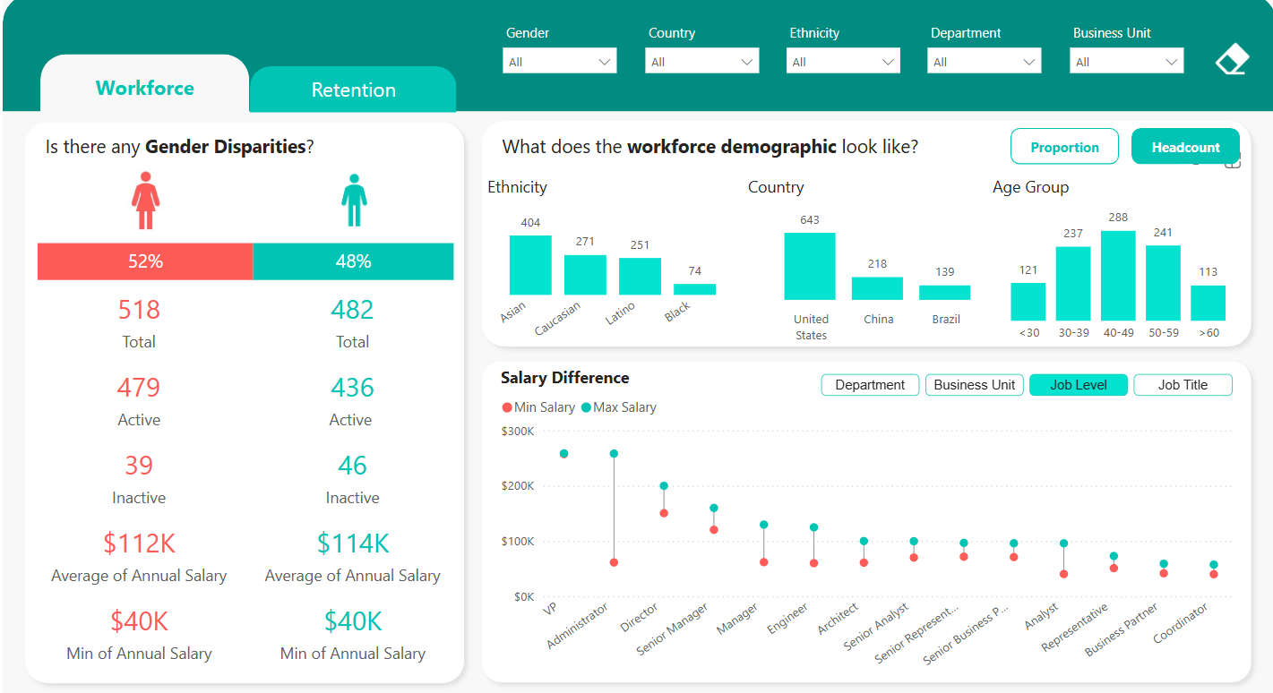
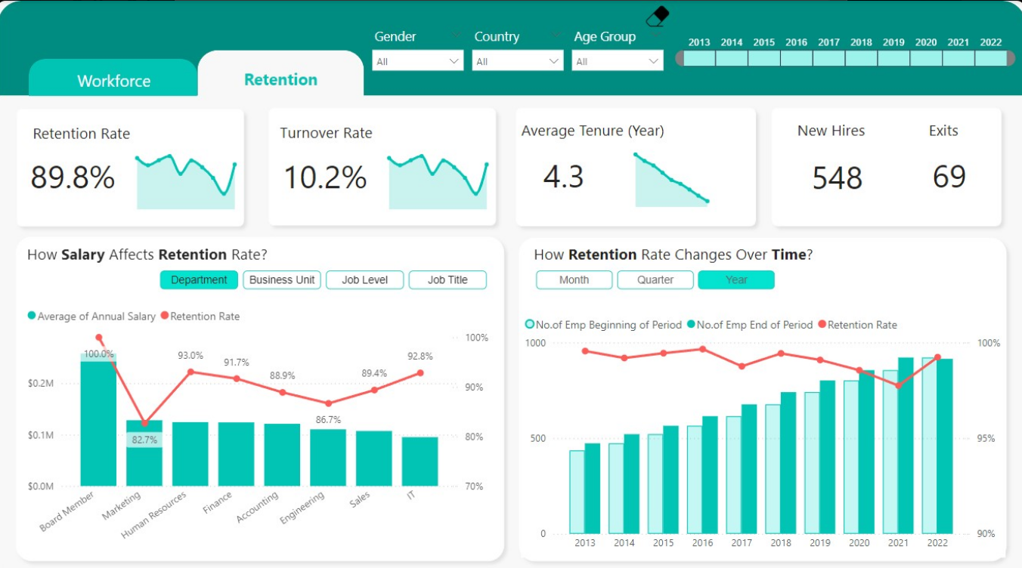
HR Analysis Dashboard – FP20 Data Challenge
Created by Hao Nguyen

Slide 13
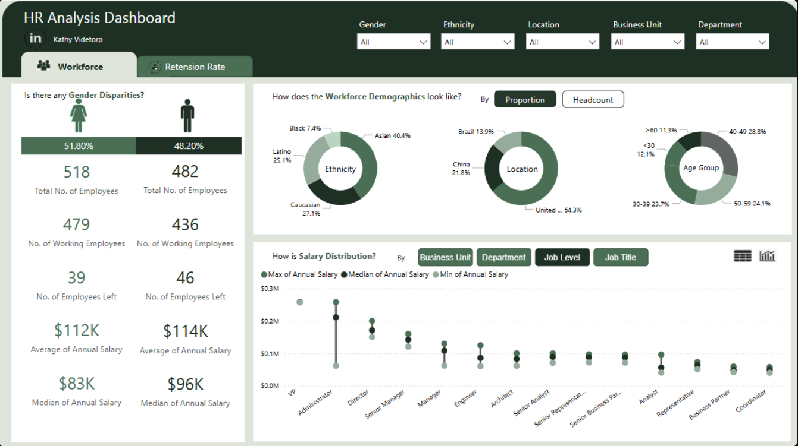
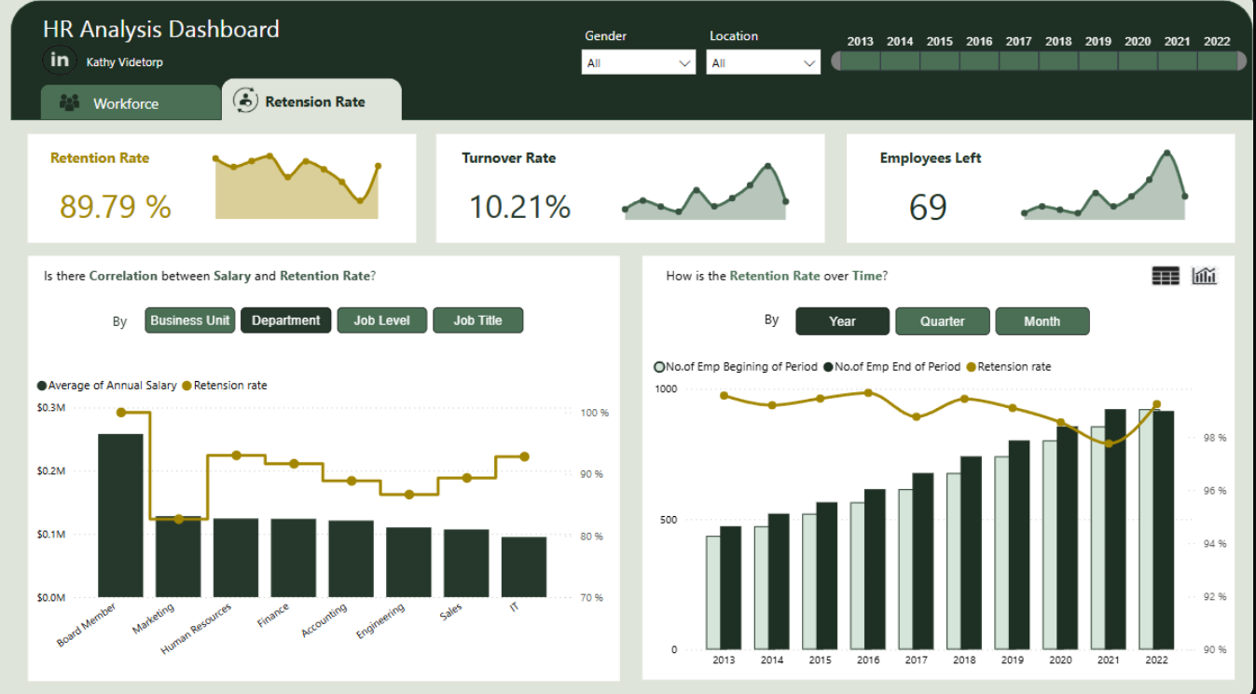
HR Analysis Dashboard – FP20 Data Challenge
Link to Linkedin post by Kathy

Slide 14
Thank you!
Anh Leimer
Any questions please contact me via:
Email: anh.leimer@gmail.com
Linkedin: Anh Leimer

